Slide 1
Getting Familiar with GenAI Applications in Tech
Christopher M. Stewart and Joseph Tyler
Linguistics Career Launch 2024
Notes:
Thanks to Tamaya, Alfonso, Emily Pace and the entire LCL24 crew for organizing this! Thank you all for your interest, time and attention. Let’s go!

Slide 2
Disclaimers!
Notes:
We are speaking from our own perspectives and do not intend to represent the views of our employers at all.
Second, all images used in this deck are taken from URLs and/or papers. The teal color indicates a link to the original. We can email you with that link, if something catches your eye.
Third, this session will not be recorded and we can’t distribute these slides. On the positive side, this is because we will soon have a book coming out which will have a chapter on this topic. Watch this space!

Slide 3
About Chris: from PhD to TT to Tech
Assistant Professor
French (Linguistics) at University of Texas-Arlington (MODL)
Cog NeuroSci research
Directed beginners’ French
Taught French linguistics
Voice Engineer
Text-to-Speech R&D at Nuance (Belgium)
Developed Siri voices
Got tech basics
Major customer-facing role
Sr. Data Scientist * 2
TCS
Developed ML pipeline for Walmart
NarrativeWave
Time series modeling of IIoT data
Sr. Computational Linguist
Google
Research Associate
University of Memphis Institute for Intelligent Systems
Notes:
And soon to be a book author!

Slide 4
About Joseph: PhD, Postdoc/Prof, Tech
Assistant Professor
Literature and Linguistics at Qatar University
Taught linguistics (intro, socio, discourse, bilingualism)
Research on discourse, intonation, socio
Postdoc
English at Morehead State
Psycholing of prosodic disambiguation (NIH grant)
Taught linguistics (intro, socio)
Conversation Designer
Sensely
Built conversation design platform, multimodal chat UI
Designed a lot of bots
Conversation Designer
Uber
Designing chatbots
Building chat capabilities, UI, tools
Notes:
And soon to be a book author!

Slide 5
About this Workshop
Day 1
15 minutes: Situating GenAI in Tech
10 minutes: Hard Prompt Design
20 minutes: One Use Case
Day 2
15 minutes: Classification in Tech
10 minutes: Other Tuning Approaches
20 minutes: Productionizing a Binary Classifier

Slide 6
Day 1

Slide 7


Situating GenAI in Tech
“[A] human will not know what it is like to be a bat through imitating bat behavior. Likewise, an LM [language model] will not know what it is like to be a human through imitating human interaction with language. An LM learns only what it would be like if it behaved like a human, within the model’s capabilities”. *
GenAI applications in “Tech” focus on the practical and profitable, which generally exclude discussions of AGI, sentience, etc.
That will be our focus in this workshop.
Prompt 1: Please generate an image of a human acting like a bat.
Prompt 2: Prompt 1 + Please make the image look more like a human than a bat.
* Language Models in Plain English: Humans Understanding How Machines Understand Language, (Eovito and Danilevsky 2021, p. 4)
Images generated by https://openart.ai/.
Notes:
OK! Obviously GenAI has made a big noise. We’re not here to present any hot takes on “Artificial General Intelligence”, “sentience”, etc. What may be interesting for linguists, though, is that it is not particularly controversial to claim that GenAI mimics human language behavior. Just like a person acting like a bat doesn’t know what it’s like to actually be a bat, LLMs don’t know what it’s like to be a human.
These questions are certainly fascinating, but mostly GenAI is used for much less lofty purposes, particularly in tech. In this workshop we’ll focus on the *practical* side of using GenAI for tech use cases.

Slide 8
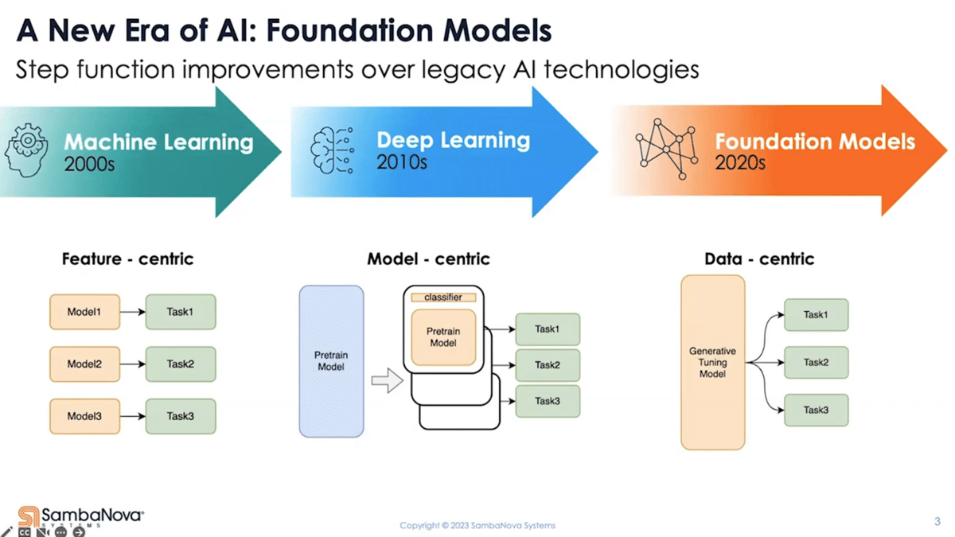
Why all the excitement now?
AI Foundation Models for Big Business Innovation
Notes:
From a modeling standpoint, GenAI has introduced a relatively new paradigm. We’ll talk about this idea in more detail in the next section, but we want to emphasize here that this is the primary reason for all of the enthusiasm. Again, this is an observation, not a value judgment. Foundation Models, the approach used by GenAI, represent a new kind of approach to probabilistic modeling.

Slide 9
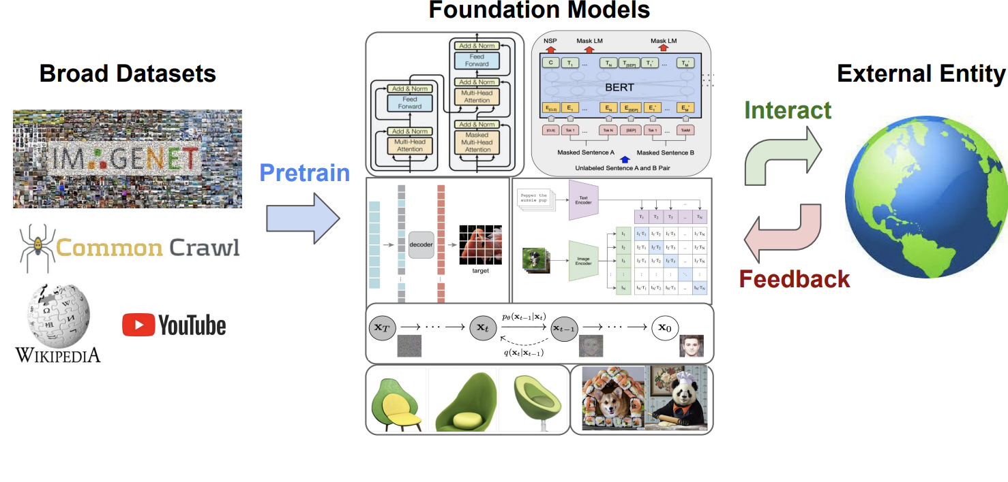
What’s in a “Foundation Model”?
Foundation Models for Decision Making: Problems, Methods, and Opportunities
Notes:
Let’s very briefly describe what goes into a Foundation Models. First, these models are trained on absolutely gigantic amounts of data. Second, they use cutting-edge modeling techniques to capture the intricacies of that data. In the top-left of the middle portion of this figure, we see the diagram from the legendary paper “Attention is All You Need”. This paper introduced the “transformer”, a “the first transduction model relying entirely on self-attention to compute representations of its input and output without using sequence-aligned RNNs or convolution”. Third, the models can be augmented with new data for steady improvement.

Slide 10
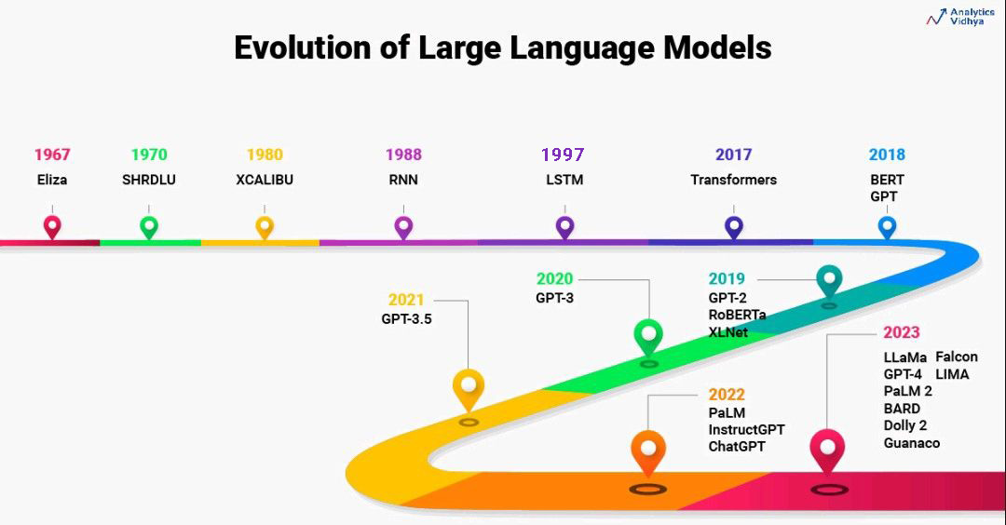
Getting to the “Foundation Model Era”: LLMs
Beginner’s Guide to Build Large Language Models from Scratch
Notes:
The “Foundation Model” approach may be new, but humans have been building models of language for a very long time. :-) In the modern era, Eliza was an early chatbot that worked by identifying keywords in sentences typed by a human and applying “decomposition rules” to these sentences to generate responses. The modern idea of a “language model” certainly predates 2023!

Slide 11
“Hard Prompt Design”
A “hard prompt” is the information that the user passes to the model, usually a combination of carefully crafted text, combined with any other inputs.
It is a static set of “hard” information in contrast to a “soft” prompt that can be tuned. More on this in the next session!
Example:
Did Khruangbin release a Spotify playlist with a mix of their favorite tunes around the time of their first album? If so, what was it called and how can I find it?
Notes:
Let’s get a bit more practical and turn to the main way that people are interacting with these models. For reasons that we’ll get into in the next session, the text and accompanying inputs submitted to a GenAI model are often referred to as “hard prompts”.
Hard vs. soft prompts.

Slide 12
Hard Prompt Design: Supplementary inputs and considerations
A “hard prompt” can include a placeholder for other information that is to be passed to the model, e.g.: Label the following image with “muffin” or “chihuahua” and never return any other response. $IMAGE
At run time, that $IMAGE tag can be converted to an image file
There is a limit on input size, so it is often necessary to chunk a long text or sample frames from a long video
Notes:
A hard prompt can also incorporate a placeholder where other kinds of content can be injected. The $IMAGE part of this hard prompt, for example, can be used to inject an image file in the prompt. This is so the LLM can evaluate both without the user having to manually insert the image every time.
“chunk a long text” = break it up into smaller parts, send each part to the LLM, union feedback for each chunk and make an evaluation of all feedbacks based on that union

Slide 13
Hard Prompt Design: Supplementary inputs and considerations (2)
A common approach to hard prompt tuning is to have a first pass, evaluate performance and then iterate on the prompt to see how changes affect performance
A few de facto strategies for improvement have come out of this iteration, all of which are well documented online
These should be a starting point when looking to improve the performance of GenAI applications as they are the easiest to implement
Notes:
How are hard prompts developed? Generally speaking, you have a go, then iterate to try to improve performance. The easiest thing is to change the prompt using some tried-and-true strategies. If any one of these is interesting to you, you can find a lot more information online. We’ll talk in the next session about more involved ways of improving performance.
Remember: this is a quickly evolving field, so these examples are not a definitive list and should be considered a very brief “intro”!

Slide 14
Hard Prompt Design: Role or Persona Pattern
This is a practice of instruct the LLM to adopt the perspective of a certain kind of person, e.g. “Explain to me like I’m 5 years old” or “You are a math professor”.
Gimmicky uses, e.g. ChatGPT in King James writing a tutorial on removing peanut butter sandwich from a VCR, highlight effectiveness of adopting new writing styles
More commonly used to ensure that responses maintain a consistent tone or approach
Notes:
Persona patterns can be useful in ensuring that the model responds with a consistent kind of feedback.

Slide 15
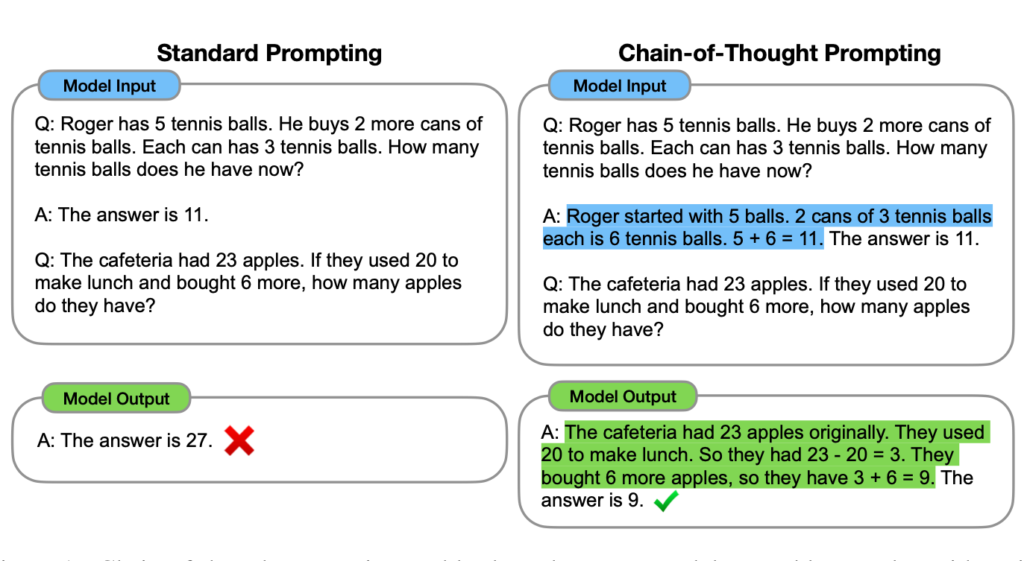
Hard Prompt Design: Chain-of-Thought Prompting
Like having students “show their work”, explicitly eliciting a series of intermediate reasoning steps can improve prompt performance
Chain-of-Thought Prompting Elicits Reasoning in Large Language Models
Notes:
Chain-of-thought prompting can guide the model to an optimal response by walking it through the steps required to get there.

Slide 16
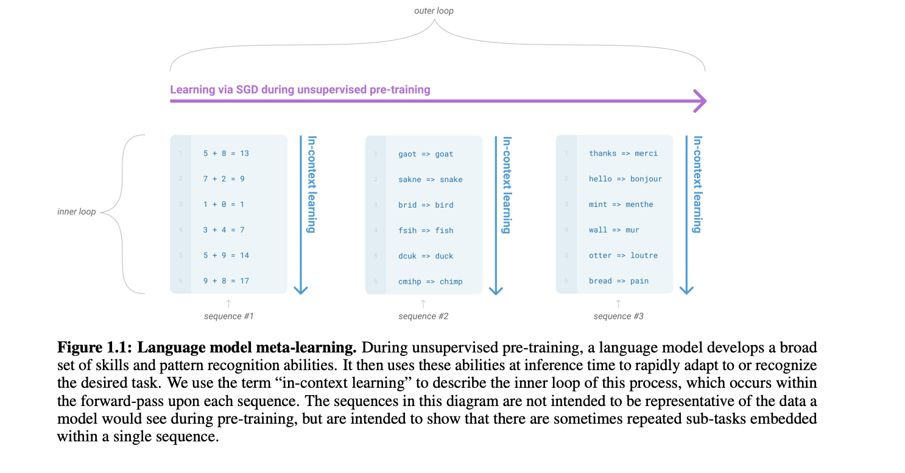
Hard Prompt Design: Zero-shot vs. few-shot prompting
A common approach in classification tasks is to provide a few labeled examples, or “shots”, to prod the model to attend to the desired portion of its hypothesis space.
Language Models are Few-Shot Learners
Notes:
Few-shot prompting involves giving the model some examples of labeled data. This figure from “Language Models are Few-Shot Learners” shows some examples of few-shot use cases: addition, spell correctors, translation, etc.

Slide 17
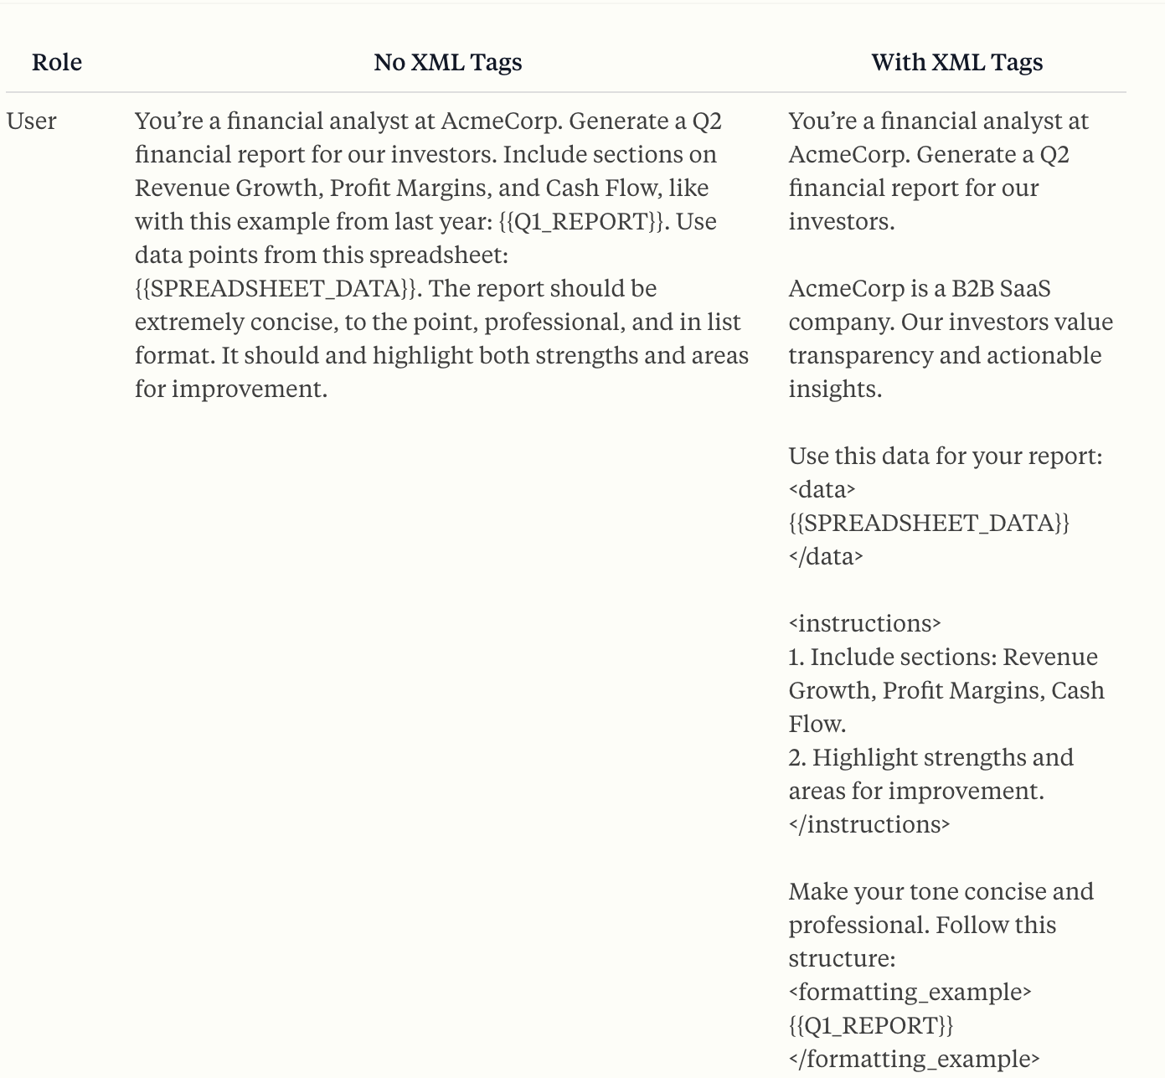
Hard Prompt Design: Prompt Formatting
Formatting the prompt using something like XML may make it easier for the LLM to parse plain text.
PROMPT ENGINEERING
Use XML tags to structure your prompts
Notes:
Finally, structuring the task more using a markup language may prod the LLM to more strictly observe how outputs should be formatted.

Slide 18
Hard Prompt Design: How much detail to put in the prompt?
There is often a “just right” quality to the prompt’s detail. Too much and the prompt may fail to generalize well. Too little and the prompt may not capture important details.
This calls to mind the bias-variance tradeoff in classification that we’ll talk about more Friday!
Notes:
Bias-variance tradeoff:
The more the model attends to details of the training examples, the better it will be at finding very similar examples, so it may not generalize well. It may have high “precision”, but low “recall”.
Conversely, a model that is too loosely attached to the training examples may fail to capture their nuances in unseen data points, but be better at generalizing to new data. It may have low “precision”, but high “recall”.

Slide 19
Use case: making a weather bot
Go to https://chatgpt.com
Generating content. Enter this:
Does it rain more in San Francisco or LA?

Slide 20
Use case: making a weather bot
Generating chatbot response content:
You’re a weather information bot trained to provide helpful answers to questions about the weather. Acknowledge the user query in your own words, give a brief answer, and encourage the user to download the app. User query: Does it rain more in San Francisco or LA?

Slide 21
Use case: making a weather bot
Intent recognition (aka classification, aka what type of question)
You’re a weather information bot trained to identify a user’s input as one of the following intents: “general weather FAQ”, “small talk”, “weather forecast”, “other”. Respond to the user query by indicating the intent. User query: Does it rain more in San Francisco or LA?

Slide 22
Use case: making a weather bot
Intent recognition AND chatbot response tailored to each intent
You’re a weather information bot trained to identify a user’s input as one of the following intents: “general weather FAQ”, “small talk”, “weather forecast”, “other”.
If the user query matches “general weather FAQ”, indicate the intent and answer the FAQ appropriately.
If the user query matches “small talk”, indicate the intent and respond with small talk, followed by asking how it can help the user.
If the user query matches “weather forecast”, indicate the intent and respond that it doesn’t have forecast data and can only answer FAQs, followed by asking how it can help the user.
If the user query matches “other”, indicate the intent and respond by saying it didn’t understand, followed by asking how they can help the user, giving an example of a common weather FAQ.
User query: Does it rain more in San Francisco or LA?
Notes:
Try entering different text after “User query” for each intent type and see what it does!

Slide 23
Homework for Session 2!
We’re going to be focusing in on classification in Session #2. Please come up with a few reviews of our weather bot and add them to https://tinyurl.com/b6xhp9rn.
These should be 1-2 sentences and have a clear label to indicate whether the review is more positive or more negative in sentiment.
Please be creative: borderline sentiment, nonsense, non-English comments, etc. are reflective of real-world comments and very much welcome!
Notes:
@Chris: Remember to share doc at that link with participants!!!

Slide 24
Questions?

Slide 25
Disclaimers!
Day 2
15 minutes: Classification in Tech
10 minutes: Other Tuning Approaches
20 minutes: Developing a Binary Classifier
Notes:
We are speaking from our own perspectives and do not intend to represent the views of our employers at all.
Second, all images used in this deck are taken from URLs and/or papers. The teal color indicates a link to the original. We can email you with that link, if something catches your eye.
Third, this session will not be recorded and we can’t distribute these slides. On the positive side, this is because we will soon have a book coming out which will have a chapter on this topic. Watch this space!

Slide 26
Let’s start by explaining this idea in more depth
AI Foundation Models for Big Business Innovation
Notes:
On Wednesday we talked about how “Foundation Models” are an evolution of probabilistic modeling that could offer a significant improvement over Deep Learning. Today we start by examining why that’s the case. To do so, we’ll take the seemingly simple case of binary classification.

Slide 27
Binary Classification (2)
Examples of Binary Classification: is this tumor malignant or benign? is this email spam or not spam? Does this comment have a more positive or negative sentiment?
In this session, we’ll talk a bit about how this is done via a traditional machine learning approach vs. a GenAI approach
This will help us see what options are available after the effectiveness of hard prompt tuning has been exhausted, but that will require a tiny bit of math!
Notes:
Classification, binary classification, etc.
Who here has studied statistics? We’re gonna do a little math before we get into how genAI foundation models are built. The point is that the math of the foundation model is NOT something you mess with, when you tune you work around the foundation model.
Binary classification is the focus today. Why is that important? Spam vs. non-spam, malignant vs. benign, etc.

Slide 28
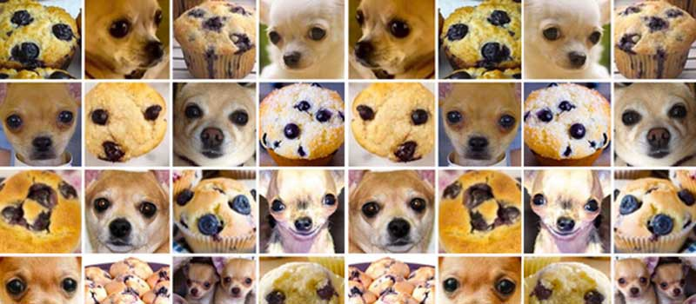
Binary Classification via Machine Learning
Input
Results
img_1
img_2
img_3
img_4
dog
muffin
muffin
dog
Program
ML
dogOrMuffin
Deep Learning Approach for Very Similar Objects Recognition Application on Chihuahua and Muffin Problem
Notes:
I’ll try to tackle this subject from an epistemological standpoint, looking at how we can predict things more broadly. If you don’t know what “classification” means, it’s simply refers to predicting the likelihood that something belongs to a “class”. As the name suggests, “binary” classification simply involves predicting how likely it is that a thing belongs to one of two categories. In this example, that means predicting how likely it is that a picture is a blueberry muffin or a chihuahua.
One approach to this problem is to get a lot of pictures of each with labels, then train a classifier such that it is able to make predictions about new pictures.
Classification, binary classification, etc.
Who here has studied statistics? We’re gonna do a little math before we get into how genAI foundation models are built. The point is that the math of the foundation model is NOT something you mess with, when you tune you work around the foundation model.
Binary classification is the focus today. Why is that important? Spam vs. non-spam, malignant vs. benign, etc.

Slide 29
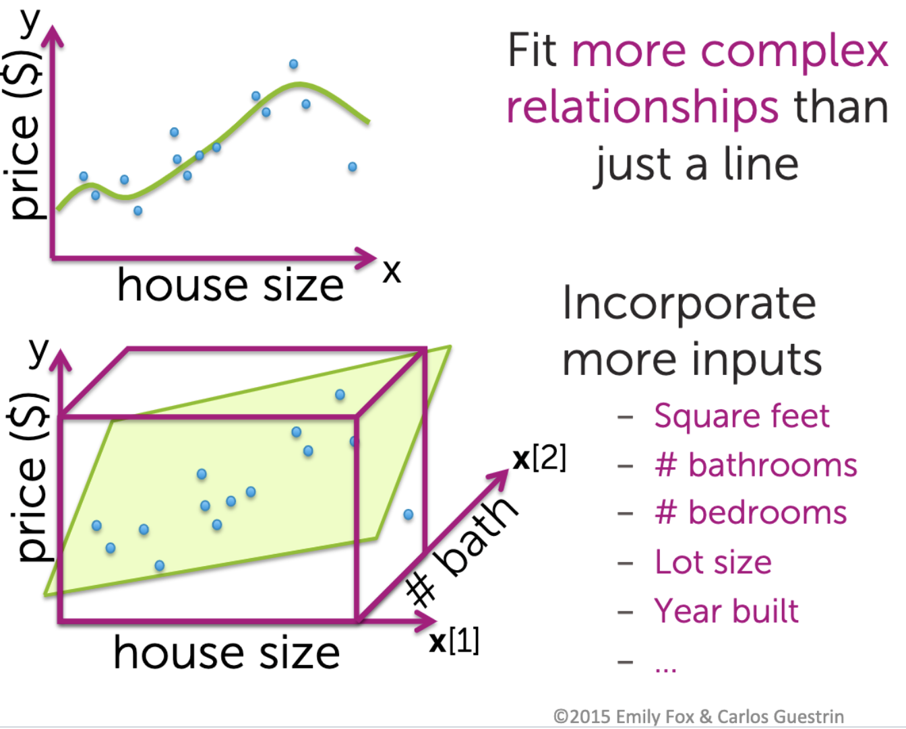
Under the hood: Predicting House Prices
Notes:
First, though, let’s step back from LLMs to think about probabilistic modeling in general. The name of the game is prediction. Suppose that you are interested in buying a house. You want to be able to predict how much any new house would cost. First, you would think about the aspects of houses that are predictive of their value: number of bathrooms, bedrooms, size, proximity to schools, age, etc.
To model this relationship, you collect lots of observations of houses and get all of this information, then try to find a “function” that minimizes the distance between each kind of information.
Here is a visualization of that process from a Machine Learning bootcamp that I took on Coursera almost ten years ago. :-) I did this at nights while I was working on my TTS job. Long days!

Slide 30
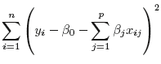
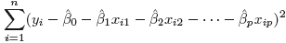
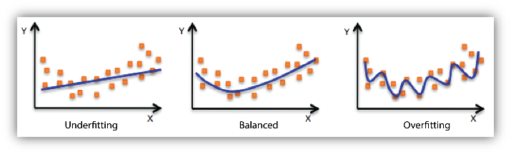
Regression and the Bias-Variance Tradeoff
Y = 𝞫₀+ 𝞫₁x₁ + 𝞫₂x₂ … 𝞫_{p}x_{p}
, minimizing RSS:
, or
Translation: To predict house prices, use known data points to approximate a function that generalizes to new houses.
Notes:
So, if we want to train a model to predict house prices based on these “features”, we start by collecting lots of observations, like our labeled pictures of chihuahuas and muffins. We then train a model with the goal of minimizing the difference between each feature’s value and the “line of best fit”. To figure out how to weight each feature, we simply calculate values that minimize the overall “wrongness” of the prediction. This is called the “residual sum of squares”, or RSS. It’s just the difference between each data point’s value and its predicted value based on an equation with certain values.
If that “line of best fit” is too loosely tuned to the training examples, it won’t predict them well as it is “underfit”. If it’s too tightly bound to the specific training examples, the model won’t generalize. It is “overfit”. The goal is to use the training data to define a function that maps features to a desired prediction. That “function” is a series of weights, represented by the betas in the OLS equation here.
To put it simply, if you want to train a model to predict house prices, you get a bunch of data points about houses: prices with information about the houses. You then put those into this framework to figure out how important each feature is. If it works well, it should be able to predict how much a house costs that isn’t in the dataset used to trained the model.

Slide 31
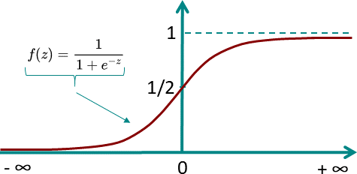
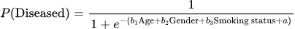
Binary Outcomes: From linear to logistic regression
Binary classification requires predictions that are, well, binary
Logistic function condenses continuous variables into a range from 0 to 1
The features are in the exponentiation
Notes:
House prices can obviously have a huge range. In “binary classification”, we’re interested in a slightly different kind of prediction: the probability that a thing is in one category vs. a different category. At a very high level, that simply involves condensing the predicted values from negative infinity to positive infinity to 0 and 1. These can be thought of as the probabilities of membership in each class. Different thresholds can be chosen to optimize the accuracy of the classifier.
The math works similarly to the linear regression example: the features are in the exponentiation.

Slide 32
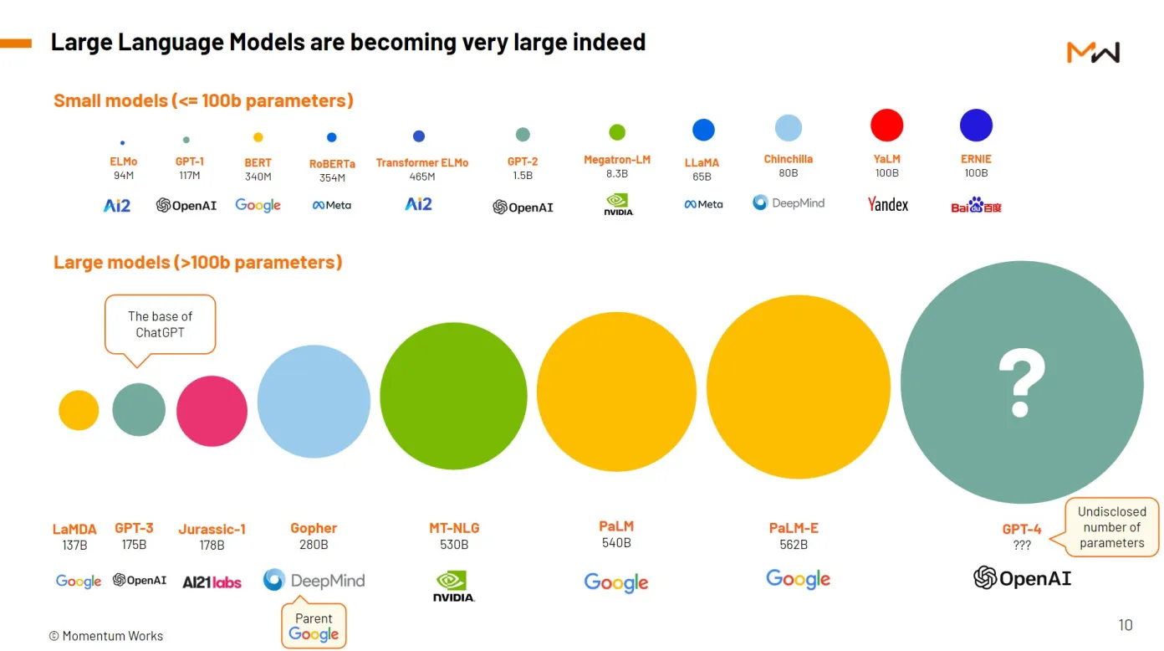
What does this have to do with GenAI?
All models use weights to predict outcomes based on inputs
But, LLMs are not regression models. :-) They are huge and very expensive / difficult to train. They have complex modeling architectures. Model calls are very expensive and may have high latencies.
The general strategy, then, is to adapt it to new tasks… carefully.
Notes:
What does all this have to do with GenAI? Well, ALL MODELS are trained. They use inputs and math to predict the most likely outputs.
But LLMs are a bit different in that they’re VERY expensive models that are very hard to build.
Once we’ve exhausted the effectiveness of hard prompt design, we have several options: we can further tune the prompt in a less intuitive way (soft-prompt tuning), adapt the output of the LLM (low rank adaptation) or try to change the relevant parts of the language model (full fine-tuning).

Slide 33
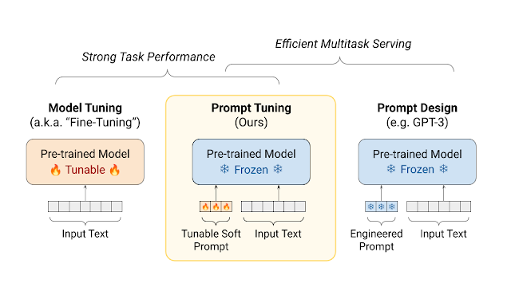
Parameter Efficient Fine Tuning: Soft Prompt Tuning
“Parameter efficient tuning” (PET) involves smaller-scale changes than full fine-tuning
Soft Prompt Tuning (SPT) can be thought of as a way to “rewrite” your hard prompt to optimize the LLM’s performance for a specific desired output
SPT is an attractive “Goldilocks solution” approach that is a good option after trying some of the prompt design tips we described last session.
Guiding Frozen Language Models with Learned Soft Prompts
Notes:
Sort of a post-processing of a hard prompt. Might be that the prompt changes wording, adds non-human readable vectors, etc. to make the prompt more flexible.

Slide 34

“Full” Fine Tuning
Not just “generative”, LLMs are “pre-trained” on giant datasets. That gets you the “G” and the “P” in GPT!
“Fine tuning” aims to freeze the general parts of the model / change the parts that have to with a specific task by introducing task-specific data points.
When use cases involve big money, further tuning the pre-trained model to improve its performance may be warranted.
Attention is All You Need
Notes:
Large language model (LLM) fine-tuning is the process of taking pre-trained models and further training them on smaller, specific datasets to refine their capabilities and improve performance in a particular task or domain. Fine-tuning is about turning general-purpose models and turning them into specialized models. It is effective, but also complicated, very expensive and potentially quite problematic (see https://arxiv.org/pdf/1312.6211), so it’s a “high risk; high reward” approach.

Slide 35
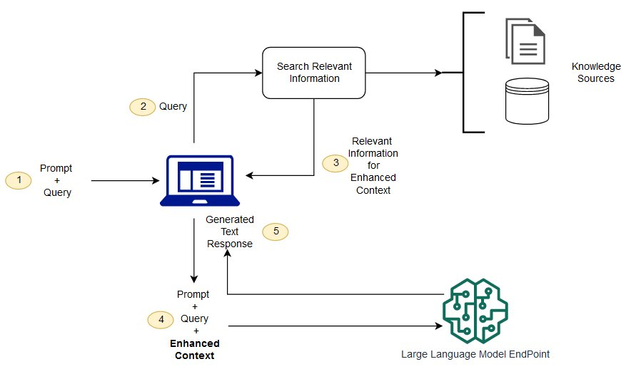
“Retrieval-Augmented Generation” or RAG
What is RAG (Retrieval-Augmented Generation)?
Notes:
And what if you really want the system to stick to “the facts”, no matter what the LLM generates?
Giving the model some information to pay attention to. Don’t generate “general purpose” information, but pay attention to our internal documentation for our use case.

Slide 36
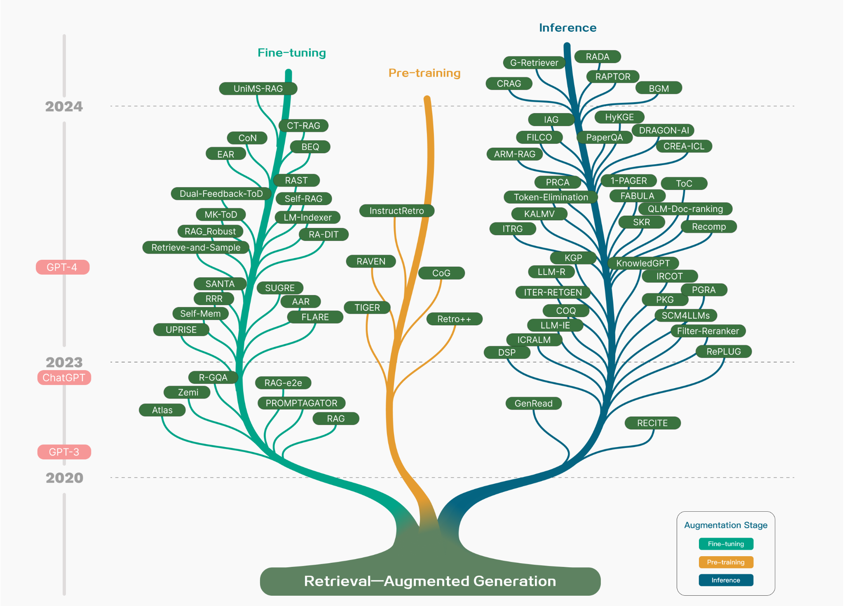
Implementing one of these gets very complex very quickly!
Retrieval-Augmented Generation for Large Language Models: A Survey
Notes:
This is a VERY hot area… So every one of these has tons of variations that implement slightly different functionalities. And we haven’t even mentioned RLHF!

Slide 37
A final very important consideration!
LLMs are typically used in service of a product
That product’s requirements may include constraints other than accuracy that guide implementation
For example, even if the LLM is amazing and perfect, if it takes 5 minutes to generate language for a product where users expect near real-time feedback, it’s not useful
A good compromise is to use lightweight models whenever possible and reserve expensive, slow models for very specific circumstances
Notes:
What are other factors that guide choices for PET? Latency, expense, server availability, chip allocations, etc.

Slide 38
Developing a Binary Classifier
Understanding the use case
Getting very high-quality labeled data
Prompt development
Expanded testing
Productionization
Monitoring
Notes:
OK, great! But building and deploying a technology that uses an LLM is much more complicated than a few ChatGPT queries!!! What is involved?
We’ll look at the first 3 now and I’ll leave the second 3 for you to consider going forward.

Slide 39
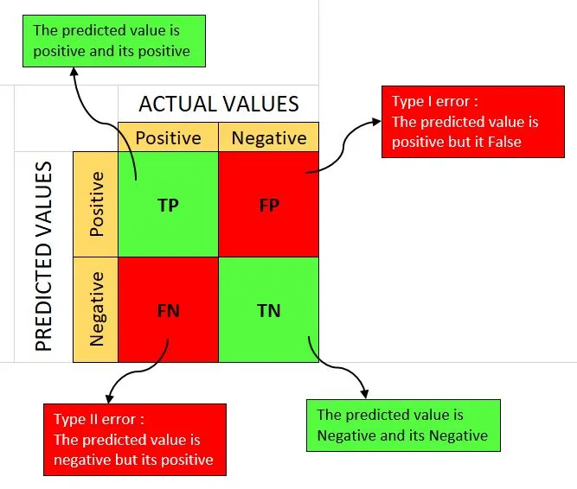
Understanding the use case
Sometimes the hardest part of the process is really understanding what the goal is
Is there an existing model that a team is trying to improve on by switching to GenAI? How will the team know if there has been an improvement?
Is it OK to misidentify things sometimes (e.g. recommender systems) or is it crucial to never miss a positive (e.g. cancer detection)? Or is generally good accuracy the goal?
Bottom line: Having a clear idea of the goal at the outset is crucial!
What is a confusion matrix?

Slide 40
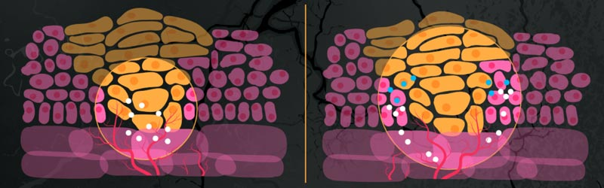
Getting very high-quality labeled data
Evaluating classifier effectiveness requires prediction on new data
There are always edge cases!
Given a comment like “dude, no way!”, should a sentiment classifier predict “positive” or “negative”? Which one of these tumors is malignant?
Cancer Cells vs Normal Cells

Slide 41
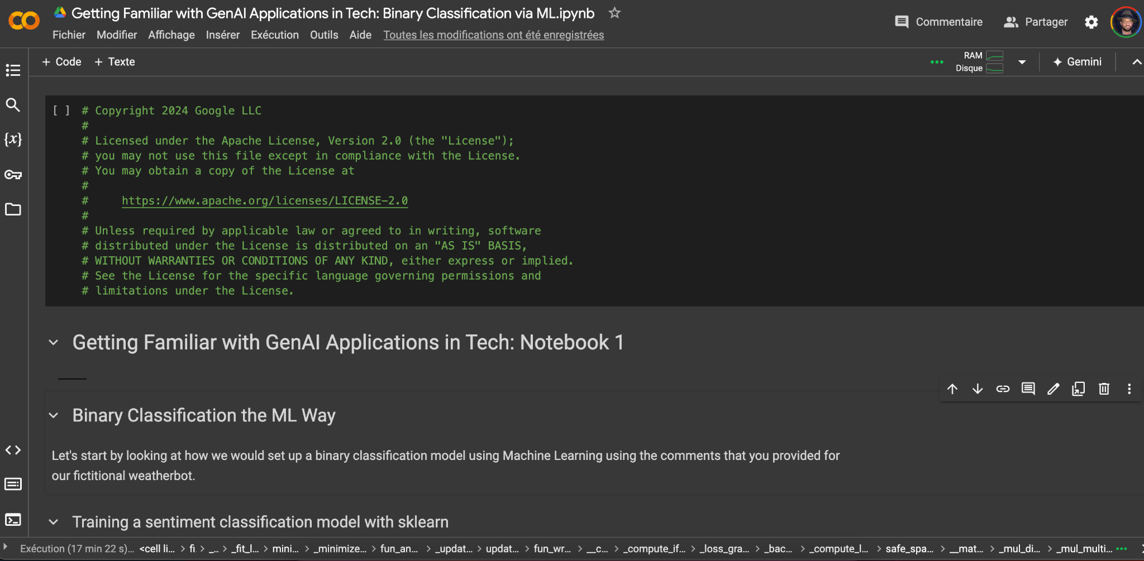
Let’s look at some examples!
Notes:
https://colab.research.google.com/drive/1Axha4G8_ZgKh2anMG1qqO6sOS-5b3LRa#scrollTo=GqJWBu60tQzq
https://colab.research.google.com/drive/1syZOmMphX-6_5RHo9u6rgo2KhXkKuohn#scrollTo=OTN5EVlaPFfQ

Slide 42
Questions?

Slide 43
Parameter Efficient Fine Tuning: Low Rank Adaptation (LoRA)
Once you have exhausted the effectiveness of hard prompt tuning, there are two parts of the system that you can touch: the prompt and the model.
SPT touches the prompt; LoRA tuning moves away from that, but stops short of really changing the model’s structure
Instead of “translating” a hard prompt, LoRA tuning relies on a supplementary layer on top of the LLM to adapt its output
It is generally more involved, expensive, difficult than SPT, but less than full fine-tuning
Notes:
https://adasci.org/lora-vs-soft-prompting-llm-fine-tuning-showdown/
To avoid changing the foundation model, we don’t change the core weights, but instead wrapping it in layers that tweaks what the foundation model does.
Consider a visualization to show what changes in each of slides 29-31.

